Slide 1
Predicting Eligibility for NSAP Schemes using Machine Learning
CAPSTONE PROJECT
Presented By:
Akash Kumar Singh-Ajay Kumar Garg Engineering College Ghaziabad-Computer Science and Engineering(CSE)

Slide 2
OUTLINE
Problem Statement (NSAP Scheme Prediction Using Machine Learning)
Proposed System/Solution
System Development Approach (IBM Services, Auto Ai)
Algorithm & Deployment
Result (Output Image)
Conclusion
Future Scope
References

Slide 3
Problem Statement
Predicting Eligibility for NSAP Schemes using Machine Learning
The National Social Assistance Program (NSAP) is a flagship social security and welfare program by the Government of India. It aims to provide financial assistance to the elderly, widows, and persons with disabilities belonging to below-poverty-line (BPL) households. The program consists of several sub-schemes, each with specific eligibility criteria. Manually verifying applications and assigning the correct scheme can be a time consuming and error-prone process. Delays or incorrect allocation can prevent deserving individuals from receiving timely financial aid.

Slide 4
Proposed Solution
We propose a machine learning-based multi-class classification model to predict the most suitable NSAP sub-scheme for an applicant using their demographic and socio-economic attributes. The model will be trained on district-level data such as gender distribution, caste categories, Aadhaar linkage, and beneficiary counts. After preprocessing and feature engineering, classification algorithms like Random Forest or XGBoost will be used. The trained model will be deployed using IBM Cloud Lite services to assist government officials in automating and improving the accuracy of scheme allocation.
Data Collection:
Gathered historical data on NSAP scheme distribution across Indian districts, including state, district, financial year, gender-wise beneficiary count, caste distribution (SC, ST, OBC, General), and Aadhaar/mobile linkage.
Utilized government-published data from AI-Kosh: District-wise NSAP Pension Data to ensure data authenticity and policy relevance.
Data Preprocessing:
Performed data cleaning and transformation, including handling missing values, encoding categorical variables, and normalizing numerical features to prepare the dataset for model training.
Engineered relevant features such as total beneficiaries by caste and gender, and removed redundant or non-informative columns (e.g., state/district names) to improve model accuracy.
Machine Learning Algorithm:
Used Snap Random Forest Classifier with enhancements such as Hyperparameter Optimization (HPO-1 and HPO-2) and Feature Engineering (FE) to improve model performance and generalization.
Achieved a high classification accuracy of 98.4 %, demonstrating the model's effectiveness in correctly predicting the NSAP scheme (scheme_code) based on socio-demographic inputs.
Deployment:
Deployed the trained Random Forest classification model on IBM Watsonx.ai Studio, enabling real-time prediction of NSAP schemes through a cloud-based interface.
Leveraged IBM Cloud Lite services for scalable, secure, and accessible model hosting, allowing stakeholders to test effectively.

Slide 5
Proposed Solution CONT…
Evaluation:
Achieved an overall accuracy of 98.4%, indicating that the model performs exceptionally well in correctly classifying the NSAP scheme based on input features.
Used a confusion matrix and classification report to evaluate class-wise performance, ensuring balanced predictions across all scheme categories (IGNOAPS, IGNWPS, IGNDPS).
Applied cross-validation techniques to verify model stability and prevent overfitting, ensuring consistent performance across different subsets of the data.
Monitored precision, recall, and F1-score, particularly to assess model reliability in correctly identifying minority class schemes.

Slide 6
System Approach
This section outlines the overall strategy and methodology used to develop and implement the NSAP scheme prediction system.
System Requirements
Operating System: Windows 10 / Ubuntu
Processor: Intel i5 or higher
RAM: Minimum 8 GB
Internet: Required for IBM Cloud access and Watsonx.ai Studio
Libraries/Tools Required
Pandas – for data manipulation and preprocessing
NumPy – for numerical operations
Snap ML (IBM) – for high-performance Random Forest with HPO and FE
Matplotlib / Seaborn – for data visualization

Slide 7
Algorithm & Deployment
Algorithm Selection:
We selected the Snap Random Forest Classifier, a high-performance ensemble-based machine learning algorithm, well-suited for multi-class classification problems. It was chosen for its robustness, ability to handle high-dimensional data, and its integration with IBM Watsonx.ai Studio, which supports hyperparameter optimization (HPO) and feature engineering (FE). The model delivered a strong predictive performance with an accuracy of 98.4%.
Data Input:
The model uses district-level socio-economic and demographic features as inputs, including:
Gender-wise counts (totalmale, totalfemale, totaltransgender)
Caste-wise counts (totalsc, totalst, totalobc, totalgen)
Aadhaar and mobile linkage (totalaadhaar, totalmobilenumber)
totalbeneficiaries, and geographic identifiers like district and state codes
Training Process:
The Random Forest model was trained using historical district-wise NSAP data. Enhancements such as HPO-1 and HPO-2 were applied to fine-tune hyperparameters, and Feature Engineering was used to select and transform the most impactful attributes. Cross-validation was also used to validate the model’s performance and prevent overfitting.
Prediction Process:
Once trained, the model takes new socio-demographic data as input and predicts the most appropriate NSAP scheme (schemecode) an applicant or district may qualify for. The deployed model on IBM Watsonx.ai Studio allows for real-time or batch predictions, making it a scalable tool for government agencies to automate scheme classification.

Slide 8
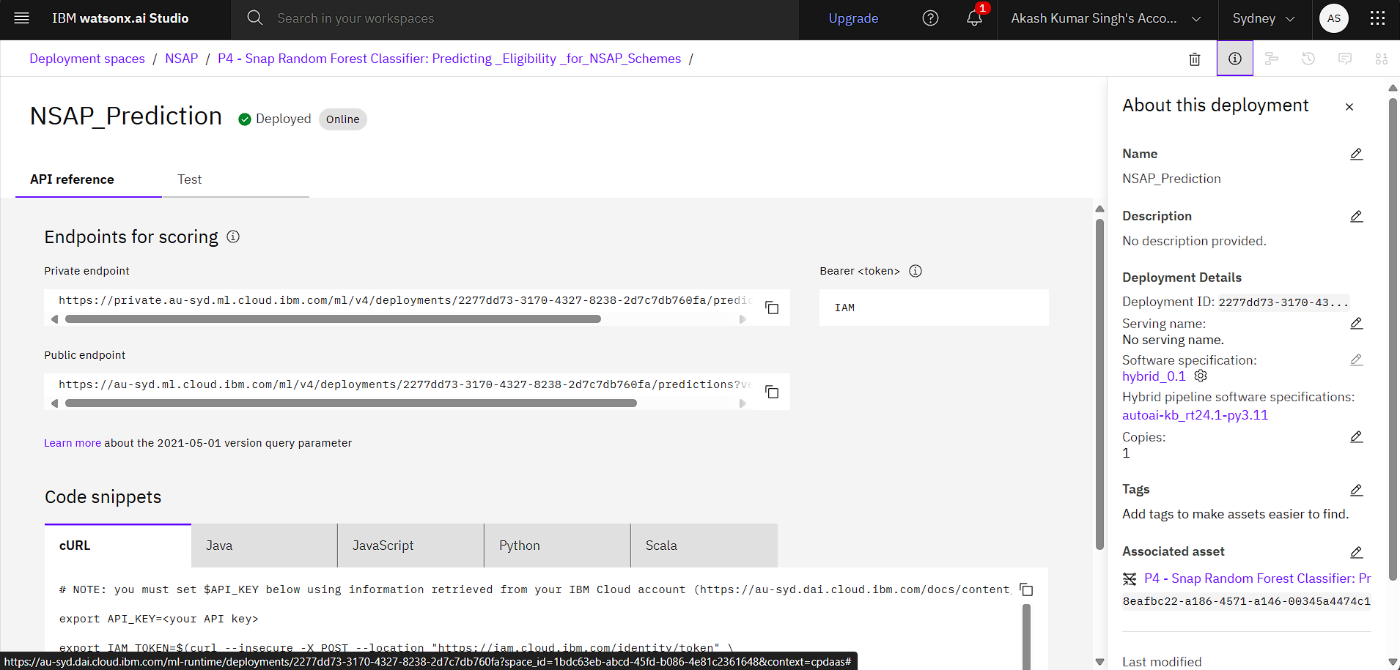
Result

Slide 9
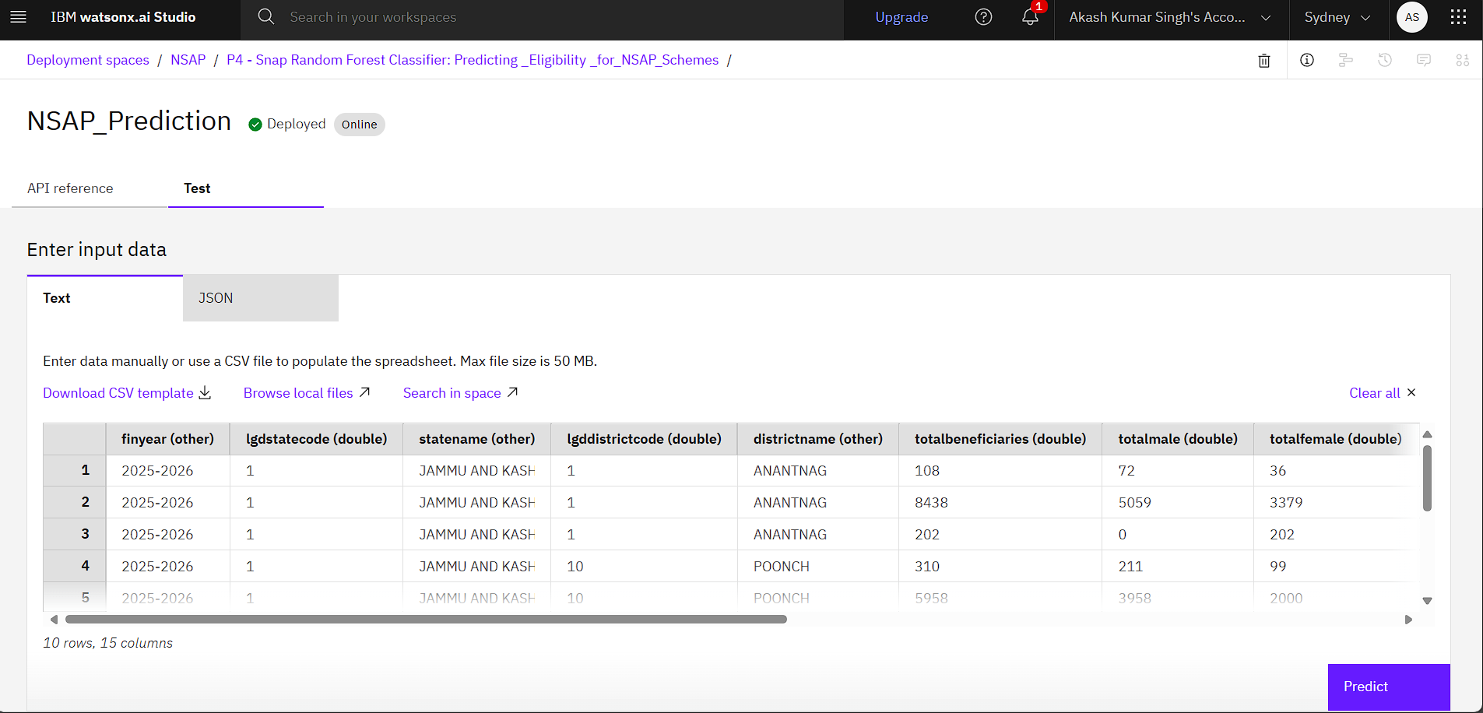
Result CONT…

Slide 10
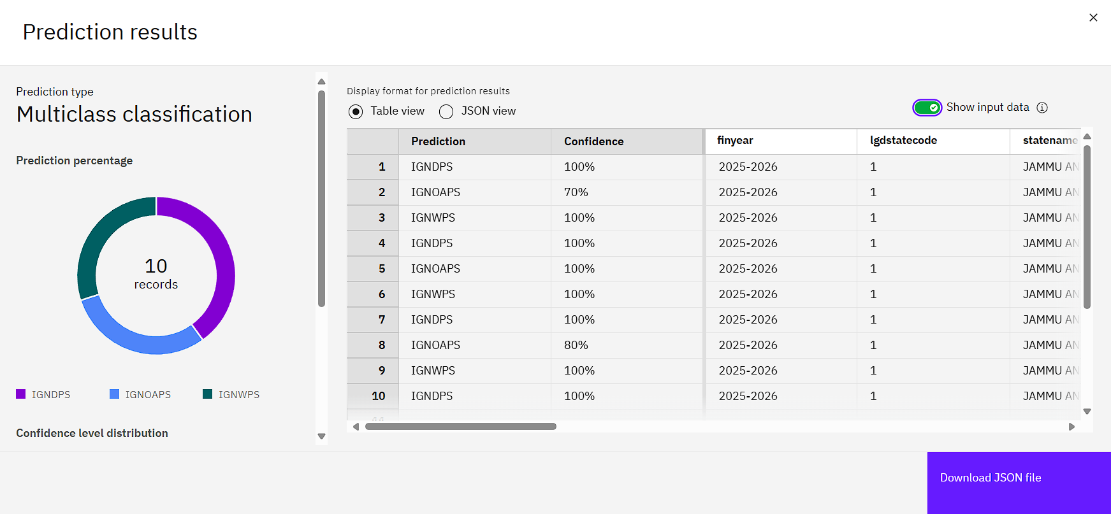
Result CONT…

Slide 11
Conclusion
Developed a multi-class classification model to predict the correct NSAP scheme for applicants.
Used an enhanced Random Forest Classifier with feature engineering and hyperparameter optimization, achieving 98.4% accuracy.
Automated scheme assignment reduces manual errors and speeds up application processing.
Deployed the model on IBM Watsonx.ai, enabling secure and scalable access.
The solution improves efficiency in welfare distribution and ensures benefits reach the right individuals faster.

Slide 12
Future scope
The system can be further enhanced by incorporating more detailed applicant-level data to boost prediction accuracy. Integration with real-time government databases will enable dynamic, on-the-spot scheme assignment. A user-friendly mobile application can also be developed for citizens to check their eligibility instantly. Adding multilingual support will increase accessibility for diverse user groups across India. Additionally, explainable AI features can be integrated to provide transparency in decision-making, and fraud detection mechanisms can be included to identify suspicious or duplicate applications.

Slide 13
References
Internship: Edunet Foundation – IBM SkillsBuild Program
Data Source: District-wise Pension Data under NSAP
Edunet Foundation – IBM SkillsBuild Program
Cloud Services: IBM Watsonx.ai, IBM Cloud Object Storage
Government Initiative Reference: National Social Assistance Programme (NSAP) – NSAP Official Site
IBM Cloud Docs: https://cloud.ibm.com/docs

Slide 14
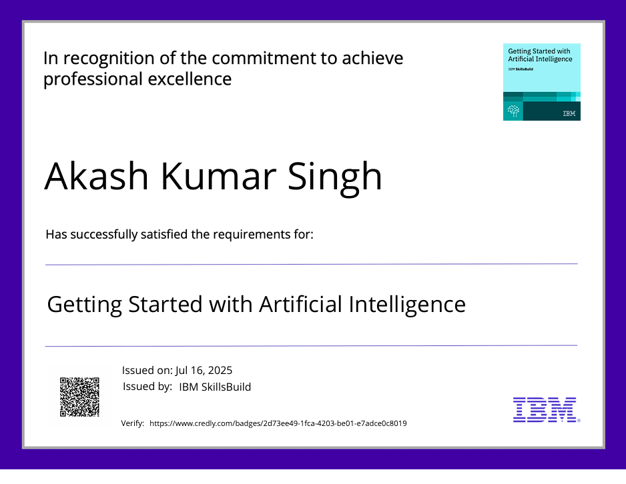
IBM Certifications

Slide 15

IBM Certifications

Slide 16

IBM Certifications

Slide 17
THANK YOU

